Slide 1
MULTIPLE WAYS OF SOLVING
TRACTABLE PROBLEMS
Good, Better, Best and the Ugly

Slide 2
Taxonomy of PROBLEMS (Thus far …)
P({0,1}*)
* Unrecognizable
Decidable but Intractable
* A_{TM}
R
RE
P
* Tractable
Today Onwards, for a while: INSIDE P, The World of the TRACTABLE!
We’ll return to deal with intractability/hard problems later on.

Slide 3
EXAMPLE: COMPUTING THE n^{th} FIBONACCI NUMBER F_{n}
0,1,1,2,3,5,8,13,21,34,55, ….

Slide 4
DEFINITION of F_{n}
Our Problem:
INPUT: n
OUTPUT: F_{n}

Slide 5
Before we begin solving …
The three clichéd questions about any (purported) algorithm:
Is it correct?
How much time (or any other resource, but usually time) does it take, as a function of the input-size n?
And can we do better? If yes, how? If not, why?

Slide 6
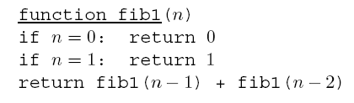
Algorithm #1 for F_{n}
Correctness is straightforward!
Assuming no memory issues
What about runtime complexity?

Slide 7
Recurrence Relation
Clearly:
Recall:

Slide 8
Algorithm #2 for F_{n}
Iteration (completely removes the overlapping computations in the recursion)
Appears to be a linear time algorithm! Is it, really?

Slide 9
Additions of Arbitrarily Large Integers
In this case, F_{n} is about 0.694n bits long … therefore addition is not a single step. Each addition is O(n) steps!
Overall runtime complexity is O(n²) steps.

Slide 10

Algorithm #3 for F_{n}
Note:
Similarly:
Consequently:

Slide 11
Is Algorithm #3 better than Algorithm #2?
Answer depends on the complexity of multiplying large integers.
Answer: Yes! Algo #3 is better!
O(M(n)logn), where M(n) is the complexity of multiplying two n-bit integers.

Slide 12

Algorithm #4 for F_{n}
Why not apply the direct formula?
Do you foresee any accuracy issues with irrational numbers?

Slide 13
ALGORITHMS FOR MULTIPLYING LARGE INTEGERS
Karatsuba Algorithm

Slide 14
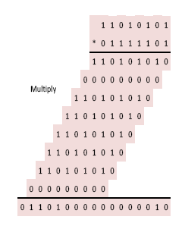
MULTIPLICATION
Given two n-digit numbers a and b,
compute a∙b
Primary School Solution
Order of n² single digit multiplications, additions and shift operations.

Slide 15
Can We Do Better Than the Order of n² Operations per Multiplication?
Yes!

Slide 16
Multiplying Two Complex Numbers
How many real multiplications are needed to compute (a + ib) * (c + id)?
Naïve Answer: 4
(ac – bd) + i(ad + bc)

Slide 17
Can You Multiply Two Complex Numbers Using 3 Multiplications?
Yes!

Slide 18
The Idea
To find (ac – bd) and (ad + bc):
Compute a∙c
Compute b∙d
Compute (a + b)∙(c + d)
(ad + bc) = (a + b)∙(c + d) – ac – bd

Slide 19
Divide-and-Conquer

Slide 20
For Example For Base-2 Numbers

Slide 22
Can We Do Better Than the Order of n^{1.585} operations per multiplication?
Fast Fourier Transform (FFT) based algorithms do it in O(nlogn loglogn) operations (1971)
Faster Methods (2007): O(n logn 2^{O(log*n)})
The best (with proof of optimality) is still … OPEN!
Fastest known: O(n logn)
(by Harvey and van der Hoeven, 2019)

Slide 23
THANK YOU
An O(nlog²n) algorithm exists for computing F_{n}. Further improvements (or lower bound proofs, currently conjectured) are awaited.
Any Questions?

